Slide 1
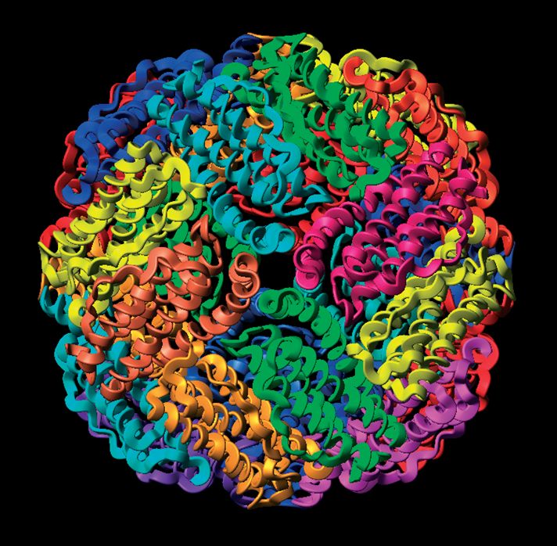
Biomimetic
Ferritins
Mineralization in Nanostructured Bio compartments: Biomimetic Ferritins For High-Density Data Storage.

Slide 2
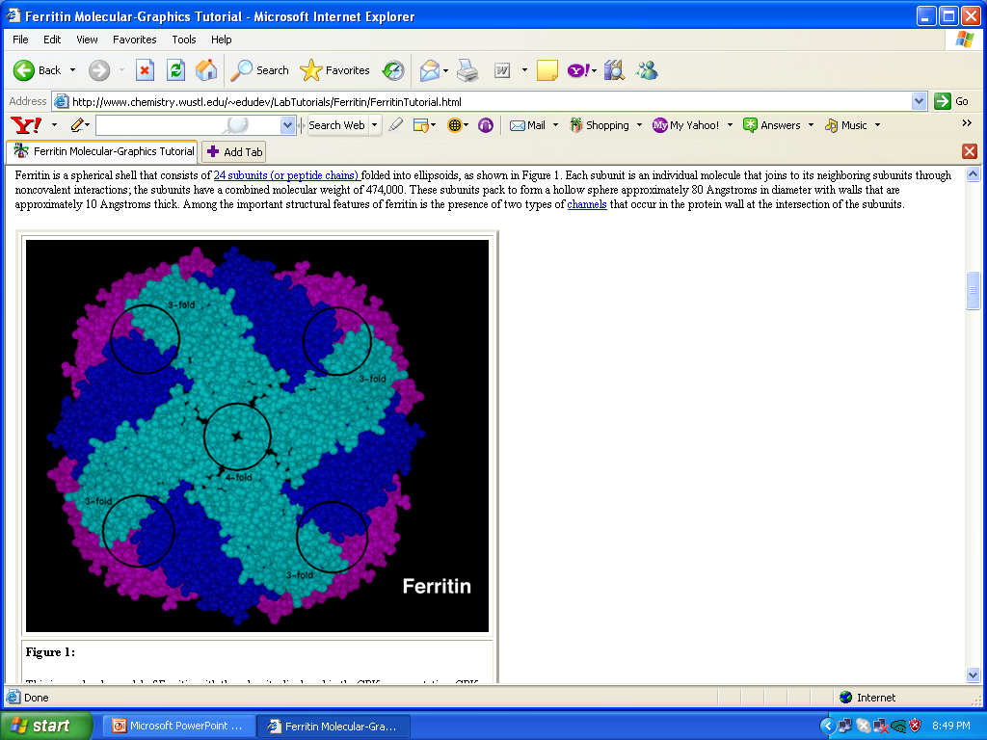
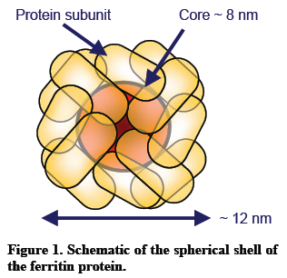
Ferritin
Ferritin is a self-assembled, 12 nm-diameter multi-subunit protein involved in biological functions such as iron storage and heme production.
24 nearly identical subunits.
Spherical shell that encloses an 8.0 nm-diameter internal cage.
Cavity contains up to 4500 Fe atoms in the form of a poorly crystalline iron (III) oxy-hydroxide mineral, ferrihydrite.
Apoferritin is robust, being able to withstand relatively high temperatures systems (65 °C) and wide pH variations (approximately 4.0–9.0).

Slide 3
Biomimetic ferritins
Ferritin cage can act as generic reaction vessel.
Biomimetic ferritins have been prepared by reductive dissolution of the iron oxide cores.
Reconstitution of the empty cage of apoferritin with manganese oxide, uranyl oxide nanoparticles, cadmium sulfide quantum dots.
Hybrid metals can also be employed like the synthesis of the magnetic alloy cobalt platinum (CoPt) within apoferritin which can help in high density data storage.

Slide 4
High-Density Magnetic Data Storage
Rectangular magnetized regions or ‘bits’ on a thin metal film supported by a glass or aluminum disk substrate.
In general, storage capacity is about maximum areal density of around 11 Gbits cm⁻² (i. e., billions of bits per cm²)
Bits are roughly 30 nm wide by 300 nm long
Composed from hundreds of nano-scaled magnetic alloy grains oriented longitudinally in the plane of a disk.
These grains are produced through a process of sputtering.

Slide 5
Sputtering
Chamber
Substrate
Deposition of thin film of target on Substrate
Ion Beam Sputtering
Reactive Sputtering
Gas Flow Sputtering
High Power Impulse Sputtering Magnetron
Sputtering Gas
Variable Size of Particles Dispersed (Poly-dispersed)
or,
Uniformly dispersed (Mono-dispersed)
Bombarding
Target

Slide 6
High-Density Magnetic Data Storage (contd.)
Polydisperse grain size distribution.
Critical to have a narrower grain size distribution when bit dimensions approach the average size of the grains (currently around 9 nm in diameter).
The “superparamagnetic limit”
Maximum density possible is anticipated to be in the region of 30 to 80 Gbits cm⁻²

Slide 7

Superparamagnetic Limits:
Most applications rely on the magnetic order of the nanoparticles being stable with time.
However, with decreasing particle size, the magnetic anisotropy energy per particle responsible for holding the magnetic moment along certain directions becomes comparable to the thermal energy.
When this happens, the thermal fluctuations induce random flipping of the magnetic moment with time, and the nanoparticles lose their stable magnetic order and become superparamagnetic.
Thus, the demand for further miniaturization comes into conflict with the superparamagnetism caused by the reduction of the anisotropy energy per particle: this constitutes the so-called ‘superparamagnetic limit’ in recording media.

Slide 8
Polydispersity
Poly-dispersed
Mono-dispersed
“superparamagnetic limit” - 9nm

Slide 9
Ways to increase storage capacity
Reduce average size of magnetic grains
Make all grains uniformly small
Pattern the uniformly small grains in 3-D arrangements.

Slide 10
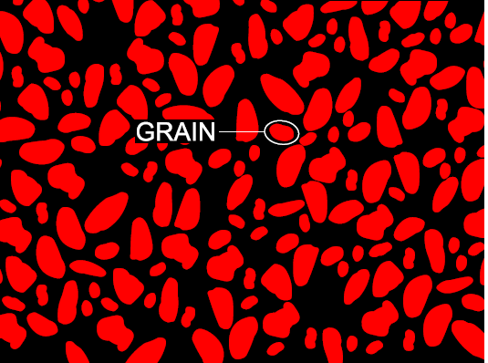
Irregular grain size leads to inefficient packing and low density data storage levels

Slide 11
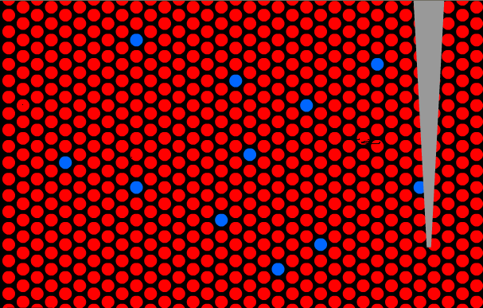
Proposed high density biomimetic ferritin based data storage

Slide 12
High-Density Magnetic Data Storage (contd.)
Sputtered thin films may have an average grain size larger than the superparamagnetic limit
Inherent size distribution leaves a percentage which is thermally unstable.
multilayer thin films that exploit antiferromagnetic coupling help to stabilize smaller grains.
Also, longitudinal recording can be extended to 80 Gbits cm^{–2}

Slide 13
High-Density Magnetic Data Storage (contd.)
Higher magnetocrystalline anisotropy are required for continually smaller, thermally stable grains.
The most likely candidates to extend areal densities significantly beyond 30 Gbit cm^{–2} are thin films comprising monodisperse high anisotropy nanoparticles.
Perpendicular magnetic orientation of grains have been proposed to extend areal densities up to 155 Gbit cm^{–2} – Polydispersed Grains.

Slide 14
Biomimetic Ferritins
Ferritin cage can as a generic reaction vessel
for nanoparticle synthesis
Steps involves
Reduction dissolution of iron-oxide core
Reconstitution of empty cage, apoferritins
Annealing

Slide 15
High-Density Magnetic Data Storage
Densities of 23 Gbits cm^{–2} have been demonstrated in the laboratory using biomimetic ferritins
Equiatomically alloyed L1₀ phase CoPt and FePt are being considered for ultrahigh-density recording films because of their high magnetocrystalline anisotropy that provides thermal stability for grains 3–4 nm in diameter

Slide 16
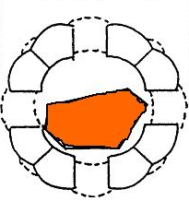
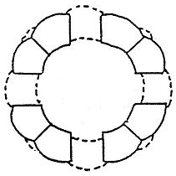
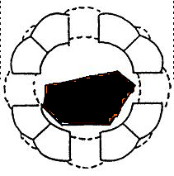

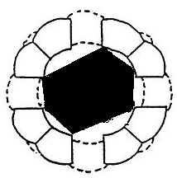
L1₀ phase CoPt Production
1
2
3
Ferritin was demineralised to produce apoferritin. This was reconstituted with Co(II) and [PtCl₄]2- and chemically reduced with sodium borohydride to form a metal alloy core. This was annealed at 500-600°C for 1hr to form ferromagnetic L1₀ phase
5
4

Slide 17
Method to prepare CoPt nanoparticles
Reduction and dissolution of native ferrihydrite
core to form apoferritin
Reconstitution of apoferritin with Co(II) and [PtCl4]2–, and chemical reduction to form a metal alloy core
Annealing of CoPt core to produce the L10 CoPt phase encased in a carbonized matrix

Slide 18
L1₀ phase CoPt Data Storage
CoPt highly anisotropic particles
Size limit due to Ferritin cage
Relatively monodisperse
Self-organising sphercal shape
2 nm protein shell prevents sintering
Possibility of forming Hexagonally close-packed (HCP) arrays of 1550 G bit cm⁻²
(Nano Magnetics Ltd U.K.)

Slide 19
Results
TEM images of a dispersion of biomimetic ferritin CoPt nanoparticles on a Si₃N₄ window prior to (1) and after (2) annealing at 550 °C for 60 minutes in H₂. Particles that are obviously separated by a protein coating prior to annealing remain discrete afterwards (a), but indistinct material exhibits sintering (b).

Slide 20
Major Highlights.
The composition,cleanliness and uniformity of the ferritin-derived nanomagnets, as well as control over their magnetic orientation, competitive materials are likely to reach the market in the near future.
Biomimetic ferritins for nanoparticle synthesis, assembly, and application offers additional significant advantages compared with more conventional technologies.

Slide 21
Major Highlights.
Self-assembled ferritin cages are readily available and naturally monodisperse, providing a reproducible system.
Inherent biocompatibility and conjugation properties of the external surface of the protein cage make these bioinorganic magnetic ferritins ideal for pharmaceutical and medical applications such as contrast agents, targeted drug delivery, and immunomagnetic labelling.
Biologically targeted semiconducting nanoparticles can also be used for rapid protein or DNA sequencing.

